Slide 1
Spring ELL Assessment Update TETN
Event# 44220
Monday, January 23, 2017

Slide 2
Disclaimer
These slides have been prepared by the Student Assessment Division of the Texas Education Agency.
If any slide is changed for local use, please remove the TEA footer at the bottom of the slide.

Slide 3
Topics
TELPAS Updates
STAAR Updates

Slide 4
TELPAS Updates
Online training and online testing information

Slide 5
Key Dates
Date | Activity
Jan 3–6 | TELPAS manuals shipped to districts
Jan 17–Apr 7 | Student data submission (student registration)
Jan 18 | Assembling and Verifying Grades 2–12 Writing Collections course available
Jan 30 | Online basic training courses for new K–1 and 2–12 raters available
Feb 13 | Calibration window opens for new and returning raters
Feb 13 | Earliest eligibility date for TELPAS writing samples
Mar 6–Apr 5 | TELPAS assessment window
Apr 6–7 | Data verification window

Slide 6
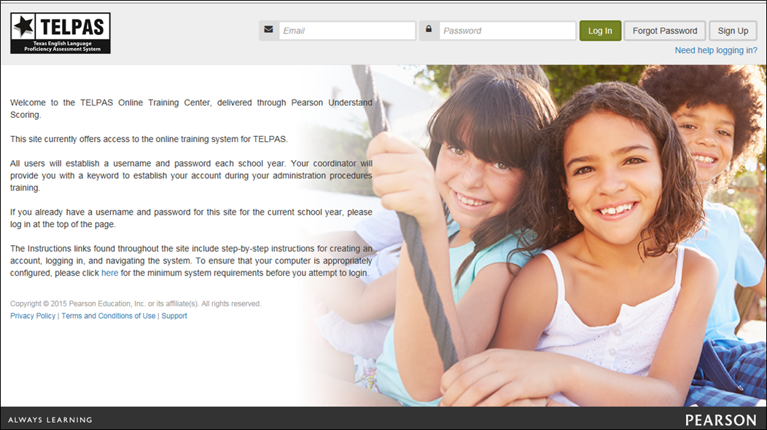
TELPAS Online Training Center
TexasAssessment.com/TELPASTrainingCenter

Slide 7
TELPAS Online Training Center Updates
New raters and returning raters who have not completed calibration activities within the last three school years are required to complete the online basic training course before calibrating.
Raters required to create new account each year; accounts purged each year
No role-based accounts (RTCs and DTCs will not have accounts created for them)
No training reports for coordinators
No account management tools for coordinators
Calibrations required to be completed in monitored session
Two sets available

Slide 8
TELPAS Online Training Center Updates
The optional Assembling and Verifying Grades 2–12 Writing Collections course is now separated into two modules (assembling writing collections and verifying writing collections).
The Grades K-1 Rater Online Basic Training Course and the Assembling and Verifying Grades 2–12 Writing Collections Course will now have a practice activity outside of the modules.
After completing the modules and practice activities for these courses, a certificate of completion will be available in the training center.
There are calibration passcodes for set 1 and passcodes for set 2 each day.

Slide 9
Monitored Calibration Sessions
Monitored calibration sessions must be completed before raters holistically rate their students for TELPAS.
Districts must establish local procedures for verifying the completion of the online basic training course before new raters can access calibration activities.
The number of calibration sessions needed depends on the number of raters that must be trained to rate the ELLs on each campus.
Most raters will need 1-2 hours to complete a calibration set. Raters must finish a calibration set once it is started in the same monitored session.
Local procedures must be established for completion of second calibration set if needed.

Slide 10
Monitored Calibration Sessions
A testing coordinator or other designated personnel must serve as a proctor.
The number of proctors needed depends on the number of raters being trained.
Proctors may be LPAC administrators, school counselors, or other suitable staff.
Proctors must not be teachers serving as TELPAS raters this year.
Proctors must have received administration procedures training and sign the rater oath.

Slide 11
Monitored Calibration Sessions
A trained proctor must be available to actively monitor the calibration session.
A roster of participants must be maintained for each calibration session.
Proctors must have correct calibration passcodes for the day of the session.
Raters may use their TELPAS Rater Manual or a copy of the PLDs and scratch paper to make notes during calibration. Any notes taken during calibration should be done on the scratch paper provided and not in the TELPAS manual. All notes taken by raters during the session must be turned in to the proctor and destroyed.
The use of headphones is required for raters to complete the calibration activities.

Slide 12
Course and Calibration Certificates
After completing the modules and practice activities for the Grades K-1 Rater Online Basic Training Course or the Assembling and Verifying Writing Collections Course, a certificate of completion will be available in the scoring summary tab of the TELPAS Online Training Center.
After completing all modules in the 2-12 online basic training course, district testing coordinators will be able to provide raters with a certificate of completion.
After successfully calibrating, raters will go to the scoring summary tab of the TELPAS Online Training Center to access and print a certificate. The certificate must be provided to the session proctor.

Slide 13
Coordinator Resources for TELPAS Holistic Rating Training
A document containing important online rater training resources for coordinators includes:
Daily calibration passcode for each set (the passcodes are updated weekly)
Sample monitored calibration session roster template
Link to the course certificate generator for 2–12 Online Basic Training Course
Should only be shared with other designated personnel acting as district coordinator assistants
Can be accessed within the Published Reports section of the TELPAS Assessment Management System

Slide 14
TELPAS Online Testing and Data Submission
K-1 (all domains) and Grades 2–12 (listening, speaking and writing) online TELPAS entry of holistic rating information will be delivered through TestNav. Grades 2–12 reading test will also be delivered through TestNav.
TestNav accessed through an installable app version.
Years in U.S. schools data collection do not break out the first year into semesters.
TELPAS testing and data submission activities will be managed through PearsonAccess^{next}.

Slide 15
TELPAS Online Test Sessions
Test sessions will need to be created for students to take the grades 2–12 reading test.
This includes separate test sessions for students approved to take a paper administration so that responses to test questions can be transcribed into a special online form.
Test sessions will need to be created for holistic rating information to be entered for each student in K–12.
Student test tickets will be used for students to log in to reading tests but are no longer required for designated personnel to enter rating information. Administrators will “Launch Test” instead.

Slide 16
TELPAS Reading Accommodations Information
TELPAS Reading Test Administrator Manual contains information about specific accommodations allowed for grades 2–12 TELPAS reading tests.
Specific information regarding student eligibility criteria and special instructions or considerations is available at the Accommodation Resources webpage.
The following procedures are not permitted, as they may invalidate the test.
Students may not receive reading assistance.
Students may not use English-language or foreign-language reference materials.
Test questions and reading selections may not be translated.
Test questions, answer choices, and selections may not be rephrased, clarified, or read to students.

Slide 17
Reports for Monitoring Completion of TELPAS Administrations
TELPAS Combined Status Report (Campus Level)
This report displays the status of K–12 holistic rating entry and 2–12 reading test for each student registered with a selected campus.
Coordinators can also verify ratings and rater information, completion of 2–12 reading tests, and entry of years in U.S. schools information.
TELPAS Summary Report (District and Campus Level)
This report displays the status of the entry of K–12 TELPAS rating information and 2–12 reading tests for a district and campuses within that district.
Report indicates the number of students with each status (Not Started, Incomplete, and Complete) for the rating and reading portions of the assessment.

Slide 18
Unsubmit and Do Not Report for Online Tests
Unsubmit
For grades 2–12 reading tests: In the event that a student or test administrator submits a student’s reading test prematurely and the student did not get the chance to complete the test, the district testing coordinator should contact Pearson’s Customer Service Center as soon as possible to get the student’s test unsubmitted. TEA must be contacted to approve this if it has been more than 2 hours since the student’s test was inadvertently submitted.
For grades K–12 rating entry form: In the event an error was made in entering holistic ratings or rater information, the district testing coordinator should contact the Customer Service Center to get the rating entry form unsubmitted to make corrections.
Do Not Report
This function is used to void a student’s online testing record. This should mainly be used for voiding student’s test records of ineligible testers (i.e. when non-ELL students are tested for TELPAS)
Function is available on the Test Details screen for online tests to district testing coordinators only

Slide 19
Years in U.S. Schools Data Collection
The Instructions for Years in U.S. Schools Data Collection document is posted on the Language Proficiency Assessment Committee Resources webpage at http://tea.texas.gov/student.assessment/ell/lpac/.
Information is also available in the 2017 District and Campus Coordinator Manual.

Slide 20
Years in U.S. Schools Data Collection
Important Reminders
Districts cannot change the value for years in U.S. schools submitted in a previous school year. Districts use the data previously submitted to inform data that will be submitted this spring.
The number of years in U.S. schools on record for a student cannot decrease. The value will either remain the same or increase by 1.

Slide 21
Data Collection Information
Required data collection for ELLs with extenuating circumstances:
Unschooled ELL asylees/refugees
Students with Interrupted Formal Education (SIFE)
This information can be submitted and updated through the Student Data Upload process.
Or can also be manually entered into the Assessment Management System.
These special circumstances are defined in the 2017 District and Campus Coordinator Manual.

Slide 22
Final Data Verification Window
Assessment window closes Wednesday, April 5
Verification window closes Friday, April 7
NOTE: The verification window will end at 5 p.m. (CT) on Friday, April 7.

Slide 23
2017 Listening and Speaking Pilot Study
Pilot study of the new TELPAS listening and speaking assessments will be conducted during the 2017 TELPAS testing window.
Information obtained from the pilot study will inform test development and administration policy decisions going forward.
Students will be registered through upload in the Assessment Management System.
Uni-directional headsets with noise-cancelling microphones are recommended.

Slide 24
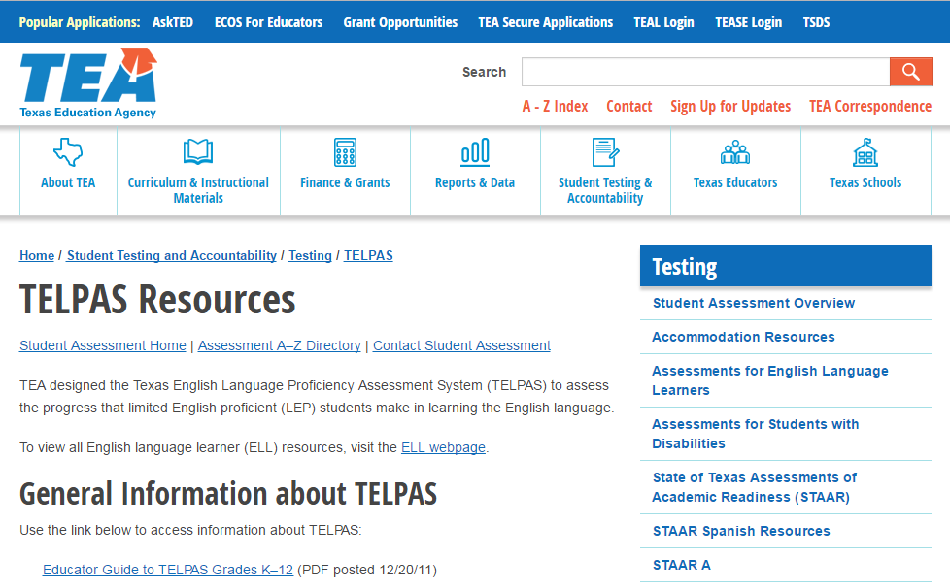
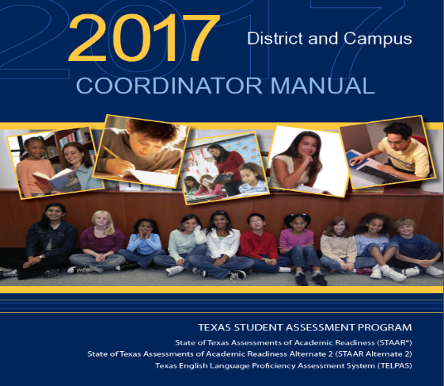
Resources
http://tea.texas.gov/student.assessment/ell/telpas/
2017 District and Campus Coordinator Manual

Slide 25
STAAR Updates

Slide 26
STAAR Participation Decisions
For Ells the following STAAR assessments are available
STAAR (with or without embedded supports)
STAAR Spanish (grades 3-5)
STAAR Alternate 2
LPACs are required to make and document assessment decisions in accordance with outlined procedures.
LPAC’s accommodation decisions must be made on an individual student basis.
Decisions will often vary by necessity because of the design of the STAAR program.
For example, it may sometimes be appropriate to give STAAR Spanish in some subjects and STAAR in English in other subjects.

Slide 27
Overview of Major Changes
STAAR offered on paper and online in all grades and subjects. (English only)
Addition of 2 new online-only embedded supports
Content Supports
Language and Vocabulary Supports
New organization of accommodation policy
Accessibility Features
Designated Supports
Designated Supports Requiring TEA Approval
Broader eligibility for many accommodations

Slide 28
Language and Vocabulary Supports and Content Supports Classroom Connection
Available in the Accommodation Resources webpage
Will guide LPACs and schools’ personnel in their decision making process

Slide 29
STAAR Online or Paper
versus
STAAR Online with Embedded Supports
These tests have the same:
selections and test questions (including field test questions)
passing standards
assessed curriculum
test blueprints
progress measures
time limits
accessibility features

Slide 30
STAAR ACCESSIBILITY
All accommodations can now be found on the Accommodation Resources webpage.
Accommodations will be divided into 3 categories with broader eligibility criteria.
Accessibility Features
Available to all students who need them
Designated Supports
The appropriate team of people at the campus level has determined and documented that the student meets the revised eligibility criteria.
Designated Supports Requiring TEA Approval
The appropriate team of people at the campus level has determined student eligibility and submitted an Accommodation Request Form to TEA.

Slide 31
Accessibility Features

Slide 32
Accessibility Features
The use of bilingual dictionaries can now be found under the accessibility features.
They are allowable for mathematics, science, and social studies assessments.
Bilingual dictionaries must be word/phrase translation dictionaries only.
They must NOT be designed to define words or to illustrate or explain content terminology or concepts.

Slide 33
Designated Supports Policy Documents
Contain the information needed to make accommodation decisions for all students taking STAAR, STAAR Spanish, and TELPAS
Each document is organized the same way
Description of Accommodation
Assessments
Student Eligibility Criteria
Authority for Decision and Required Documentation
Examples/Types
Special Instructions/Considerations

Slide 34
LPAC as Independent Authority for Decisions
Oral/Signed Administration
Content Supports
Language and Vocabulary Supports
Extra Time
Dictionary
Basic Transcribing
Large Print
Amplification Devices
Manipulating Test Materials
Mathematics Manipulatives
Projection Devices
Individualized Structured Reminders
Supplemental Aids

Slide 35
Accommodation Recommendations for Reading and Writing: Impact on Exit Criteria for ELLs
Students for whom the LPAC recommends the following designated supports for any reading or writing assessment, may not be considered for exit at the end of the school year.
Dictionaries (this applies only to grades 3-5 since the use of dictionaries as a designated support is considered an accommodation for these grades only)
Oral Administration
Language and Vocabulary Supports
Extra Time

Slide 36
STAAR Dictionary Accommodation Policy
According to #3 under “Special Instructions/Considerations” in the Dictionary accommodation policy document, if a student in grade 6 or above needs a dictionary not listed in the STAAR Dictionary Policy:
“Dictionaries are a required part of standard test administration procedures (and not considered a testing accommodation) for some state assessments. For more information, refer to the STAAR Dictionary Policy located on the TEA’s STAAR Resources webpage. If a student in grade 6 or above needs a dictionary not listed in this policy, contact TEA’s Accommodations Task Force.”
This applies only to picture dictionaries, which is the only type of dictionary listed on the Dictionary accommodation policy that is not also listed on the STAAR Dictionary Policy.
Instead of contacting TEA, adhere to the following guidance: For STAAR reading and writing assessments for grade 6 or above, a picture dictionary (listed in the Examples/Types section of the Dictionary accommodation policy) may be provided, along with the required dictionary from the STAAR Dictionary Policy, to a student who routinely, effectively, and independently uses a picture dictionary during classroom instruction.

Slide 37
Documenting Accommodation Decisions for ELLs Receiving Special Education Services
In the case of an ELL who receives special education services, the ARD committee in conjunction with the LPAC shall determine and document the need for allowable testing accommodations in accordance with Texas Administrative Codes (TAC) §101.1003(c) and §101.1005(e).
It is important for the LPAC to be mindful of the confidentiality requirements for students with disabilities when documenting these decisions.

Slide 38
Suggested Forms for LPAC Use
STAAR Participation and Accommodation, or Designated Support, Decisions
Eligibility for STAAR English I Assessment Special Provision
Student History Worksheet
Forms may be modified and reformatted for local use (Microsoft Word format).
School districts may require additional supporting documentation and evidence.
Reminder: Accommodation decisions should be made as close as possible to the assessment to account for student’s progress.
Available at http://tea.texas.gov/student.assessment/ell/lpac/
Notes:
Reminder: Accommodation decisions should be made as close as possible to the assessment to account for student’s progress.

Slide 39
STAAR Participation and Accommodation Decisions
Part II of this form lists test accommodation (designated supports) decisions that LPACs have sole authority for recommendation.
Braille, calculation aids, and spelling assistance decisions have to be made in conjunction with the ARD or section 504 committees, therefore, are not listed here. These decisions must be recorded and included in student’s permanent record file.
This form can be modified or copied and provided to testing coordinators.
ELLs for whom the LPAC determines eligibility for content supports and/or language and vocabulary supports must take the online administration. If a student receiving these supports requires a paper administration, a paper request form needs to be submitted; however, paper tests are approved by TEA in rare circumstances.

Slide 40
Recording Accommodations on the Answer Document
District and Campus Coordinator Manual
Campus personnel must be trained in accurately recording accommodations on each student’s answer document or in the Assessment Management System for online administrations.
Record the accommodation that is documented and made available to a student, even if the student did not use the accommodation during testing.

Slide 41
Special Paper Request Process
Because Language and Vocabulary Supports and Content Supports are embedded accommodations presented in an online format, replicating these features in a paper version is not always possible.
Technology-based accommodations enable most students to test online; however, in instances in which the use of an accommodation is not feasible or appropriate, or if the administration of an online test is inappropriate due to a student’s particular disability, a special request may be made to TEA for approval to administer a paper test booklet.
The paper administration request document is updated and posted on the TEA’s District and Campus Coordinator Manual Resources webpage.

Slide 42
Special Paper Administrations of STAAR with Embedded Supports
In addition to receiving training on general test administration procedures and test security, test administrators need to be trained in testing procedures specific to STAAR with Embedded Supports paper administrations.
Providing Language and Vocabulary Supports and Content Supports is different than in years past.
Training Materials located on the Accommodations Resources webpage include:
Non-secure sections of the Paper Administration Guides (available soon)
Additional training resource (available soon)

Slide 43
Organizing Test Administrations
In some cases, students taking STAAR administrations may be grouped across programs, grades, and subject areas or courses.
Organize test sessions in which students are given different tests in a way that keeps students from being confused or disturbed by differences in directions read aloud or accommodations provided.
Students using certain testing accommodations or allowable procedures may need to complete the test in a separate setting to eliminate distractions to other students and to ensure the confidentiality of the test.

Slide 44
Preparing ELLs for Testing with Designated Supports
In training test administrators with ELLs in their sessions, make sure to review this section of test administrator manuals.
Administration “SAY” directions assume ELLs have been told in advance
how their sessions will be conducted
what type of accommodations they may receive

Slide 45
Helping ELLs Understand Test Directions
For all tests, ELLs may be helped to understand “SAY” directions and test booklet directions that introduce test sections or item formats. Test administrator is allowed to:
paraphrase
translate
repeat
read directions aloud
Test administrator is not allowed to add directions that are substantively different (no pointers, no test-taking strategies, etc.).
STAAR tests have no sample items; familiarize new ELLs with item formats ahead of time using released tests on TEA website.

Slide 46
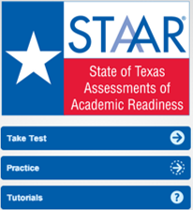
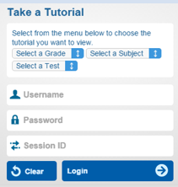
STAAR Online Student Tutorials
Can be accessed from STAAR Online Testing Platform
Tutorials help students learn how to use the supports and read aloud accommodations as well as standard online tools.
Self-guided--Students move through tutorial at their own pace
No teacher administration directions

Slide 47
Assessing Newly Arrived ELLs Who Know Little English
In isolated situations if completing an assessment is not in the best interest of a student (e.g., a newly arrived ELL who has extremely limited English language skills), the campus may make the determination to submit the test for scoring without requiring the student to complete test.
The decision should be documented and communicated to student’s parents after the test administration.

Slide 48
Exemption for Qualifying Unschooled Asylees and Refugees
Amendment to 19 TAC §101.1005 allows for the exemption of certain qualifying ELL asylees and refugees from being administered a STAAR assessment in grades 3–8.
This exemption only applies to those unschooled asylees and refugees in their first year in U.S. schools.

Slide 49
English I EOC Special Provision TAC §101.1007
For ELLs who ―
have been enrolled in U.S. schools 3 years or less (5 or less if qualifying unschooled asylee/refugee), and
have not yet attained TELPAS advanced high reading rating in grade 2 or above.
Why this provision? In English I and ESOL I courses, these students may require substantial instructional scaffolding and linguistic adaptation not feasible on standardized language arts assessments.
Notes:
Why this provision? In English I and ESOL I courses, these students may require substantial instructional scaffolding and linguistic adaptation not feasible on standardized language arts assessments.

Slide 50
Special Provision
When enrolled in an English I/ESOL I course, an eligible ELL shall not be required to retake assessment each time it is administered if student passes course but does not pass the test.
NOTE:
Students are not exempt from testing while in the course.
Provision does not apply to English II.
This provision is not tied to any particular graduation plan.
Notes:
NOTE:
Students are not exempt from testing while in the course.
Provision does not apply to English II.
This provision is not tied to any particular graduation plan.

Slide 51
ELLs with Parental Denials
LPACs may not recommend designated supports, special assessment considerations, or accountability provisions for an ELL whose parents have denied bilingual or ESL services.
This includes:
No accommodations or designated supports
No testing in Spanish
No English I special provision
No unschooled asylee/refugee provisions

Slide 52
Resources
LPAC Resources webpage:
2017 STAAR Decision-Making Guide for LPACs
ELL Assessment Documentation Forms
Accommodation Resources webpage:
Classroom Accommodations and the Link to Language and Vocabulary Supports and Content Supports
Educator Guide to Accessibility within the STAAR Program (this guide takes the place of the “Linguistic Accommodations for ELLs Participating in the STAAR Program” document) (Coming Soon)
Accommodation Policy Documents

Slide 53
Contact Information
Email ELL Assessment team at ell.tests@tea.texas.gov
Call Student Assessment Division at 512-463-9536
ELL Assessments Information webpage
http://tea.texas.gov/student.assessment/ell/
Accommodations Resources webpage
http://tea.texas.gov/student.assessment/accommodations/

